Slide 1

Media Matters: The Decisions Made
Examining major choices at CNN and Paramount Global
Eva Hill and Morgan McEnany, University of Iowa
JMC:5269:0EXW Media Management
August 2, 2023

Slide 2
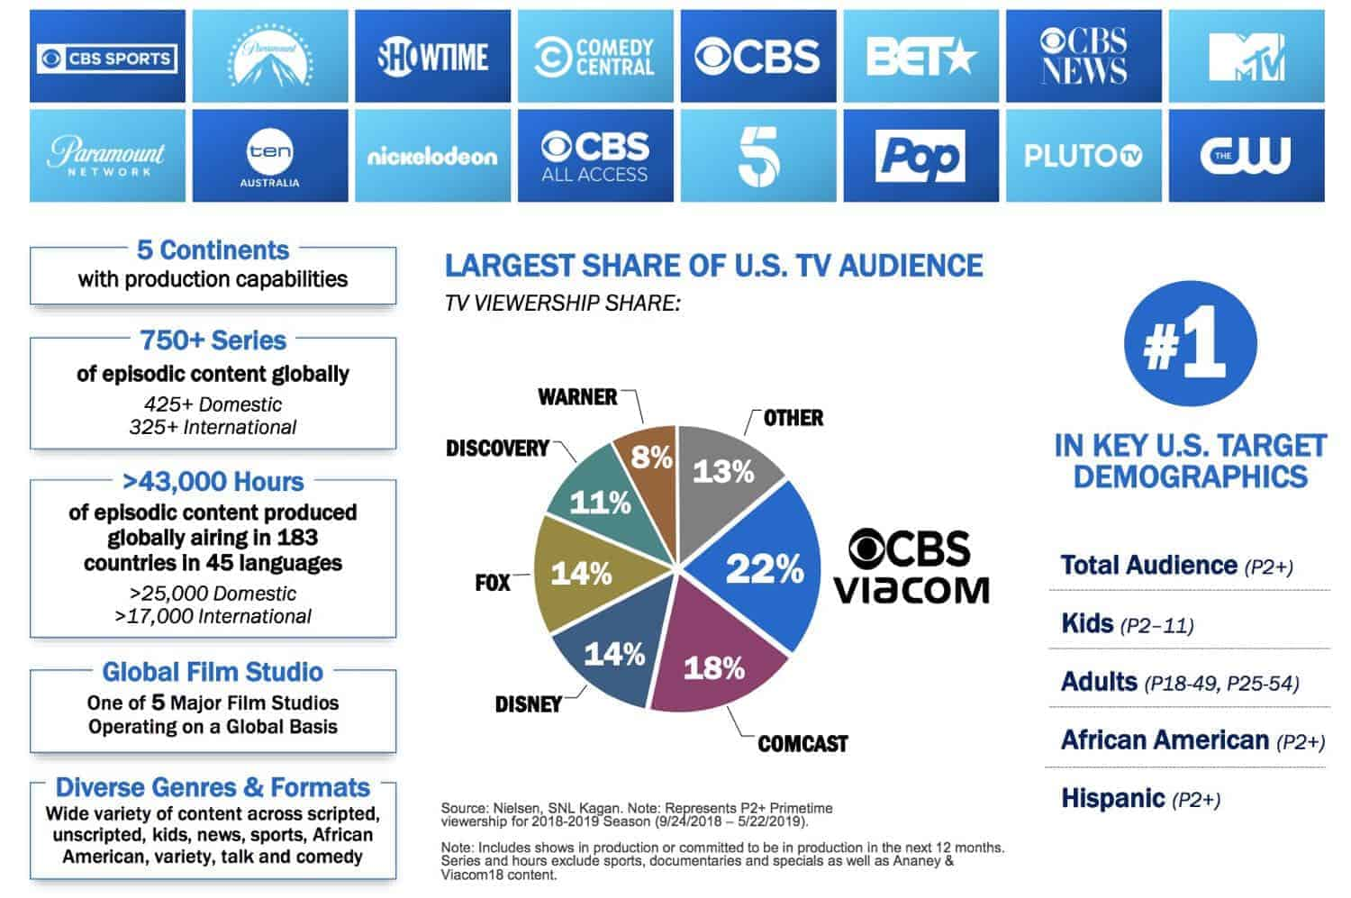
Background
Major players: Viacom and CBS
Merger followed decades of back-and-forth between the companies
Paramount Global (renamed after the merger) holds plurality of the US market share
Viacom and CBS together own many influential and/or nostalgic properties, including MTV, Nickelodeon, Comedy Central, BET, and Paramount
Graphic from a presentation by ViacomCBS regarding the merger

Slide 3
Narrative
Paramount+ represents a new entry from ViacomCBS (rebranded as Paramount Global in 2023) in the streaming market
Symbolic of CBS's new willingness to work with Viacom
Paramount Global name change is also symbolic, intended to emphasize renewed focus on streaming and digital-first content, according to the chair and CEO
Rebranded version of CBS All Access, which offered CBS shows, news, and sports (with live TV included for premium subscribers)
Paramount Global emphasizes its ownership of a wide variety of streaming options, from FAST platform PlutoTV to the relatively expensive live TV tier of Paramount+

Slide 4
The Paramount+ Launch
Pros
Cons
Unlikely to experience the same growing pains Netflix did in the live TV arena
Paramount+ owns popular existing content
Option to pull in content from other Paramount Global networks and properties (like Showtime, BET, Nickelodeon, etc)
Streaming market is saturated already, and Paramount+ came in at the usual price point
New series and movies from Paramount Global have been generally less popular than their older properties
Not building on a huge existing audience

Slide 5
Background
CNN is a multinational news network within the media sector.
Founded in 1980 by Ted Turner
Competitors:
Originally, ABC, CBS, and NBC
Led to Fox News and MSNBC
News shifting to politically charged
Notes:
CNN or Cable News Network. It is a multinational news network within the media sector. Found by Ted Turner in 1980. Competitors when it first started were the big three: ABC, CBS, and NBC. CNN's business model led to Fox News and MSNBC who joined their competitive space. Around the 2010's, the news started to shift into being politically charged.

Slide 6

Narrative
2013
2016
2018
2020
2021
2022
Jeff Zucker starts as CEO
AT&T deal
AT&T acquires Time Warner
Zucker skirts internal policy
September
Supports Cuomo during legal investigation
December
Zucker fires Cuomo
Zucker's forced resignation

Slide 7
Zucker + Decisions made
Chris Cuomo:
Allowed him to interview brother
Investigation opened into the relationship
Suspension
Fired
Allison Gollust:​
Knew Jeff while publicist for TODAY
Hired by Jeff to CNN
Relationship evolved; undisclosed
Notes:
Jeff Zucker and Decisions he made, looking specifically at two of his employees. Chris Cuomo was an achor for CNN. Jeff ignored internal policy to allow him to interview his brother who was a political figure, New York Governor Andrew Cuomo. A legal investigation opened up into Chris’s relationship with his brother as Andrew Cuomo dealt with sexual misconduct allegations from the media. Ultimately, the investigation was looking into whether Chris had helped his brother in anyway and looking at issues with journalistic integrity. Jeff originally supported Chris and wouldn’t suspend him at first. What we see happen is the investigation expanded and he was suspended. Within less than 24 hours, Chris was fired. This came from a sexual assault allegation against him from a former co-worker at a different media network.

Slide 8
Challenges
Infighting and controversial resignations/firings
Struggle to stay relevant in a changing landscape
Presenting a solid public front through signs of instability
Failed, unpopular, or unprofitable streamers (CNN+, CBS All Access)
Unclear outcomes
  Who will the next CEO of CNN be? Will they stick around?
  Will Paramount+ pay off?

Slide 9
Takeaways
Tricky, if not impossible, to smoothly run a media company at the scale of CNN or Paramount Global
Change is constant
If you sit still, you die
Notes:
Change is constant in the media space and everything is playing out in front of the public. We see changes come from mergers & acquisitions with changes in management along with the decisions made by executives. If you sit still, you die. Both companies had to do what needed to be done with the decisions they made. For CNN, Jeff Zucker seemed to be well-liked but allowed questionable decisions to be made when it came to the network’s journalistic integrity and not disclosing the change in relationships. Paramount Global introduced the Paramount+ streaming service is a way to keep the company relevant though it was also slightly a rebrand of CBS All Access and Viacom entertainment rolled into one service. Paramount+ also would have to remain relevant to compete in this space.

